Slide 1
Large Language MadLibs
Part 2
Created by Kristin Fasiang and the Creative Interfaces Research + Design Studio

Slide 2
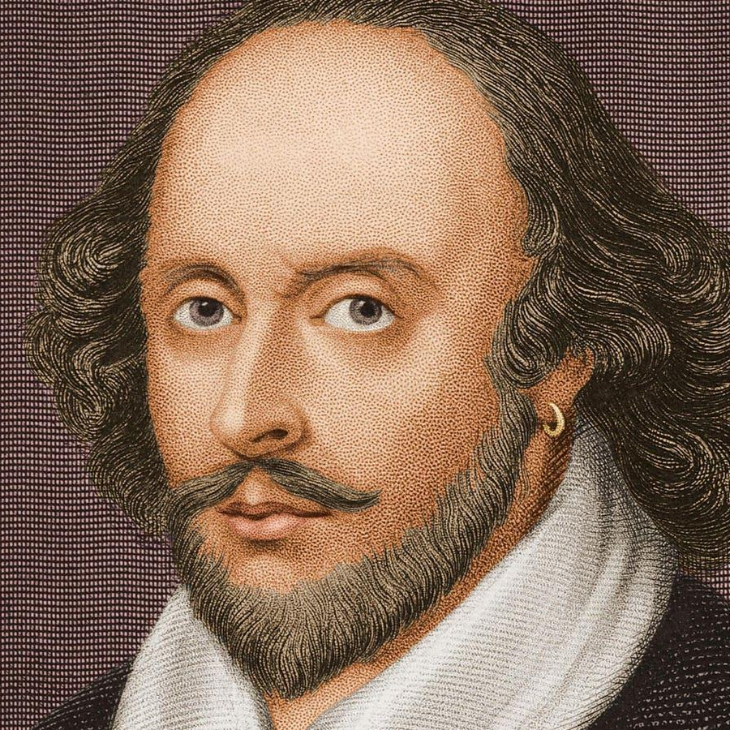
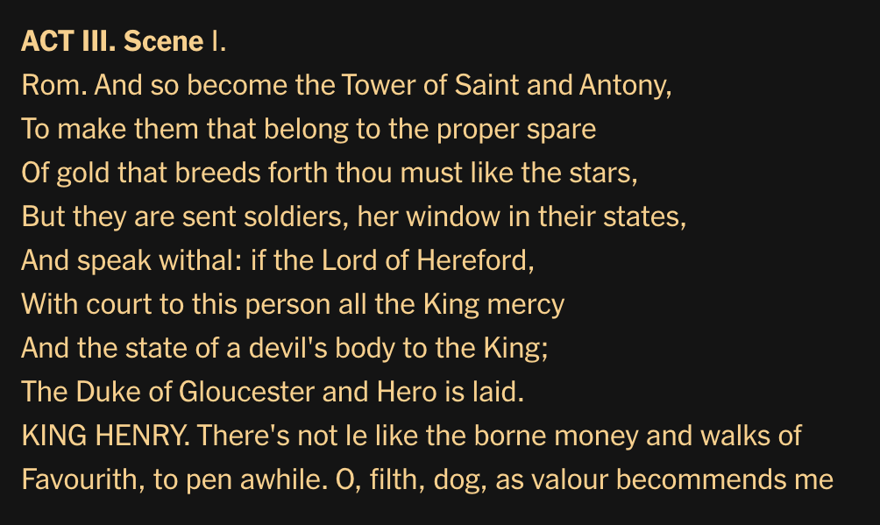
Big Idea
When we don’t take into account the words that come before a
blank, it’s hard to fill it in a way that makes sense.

Slide 3
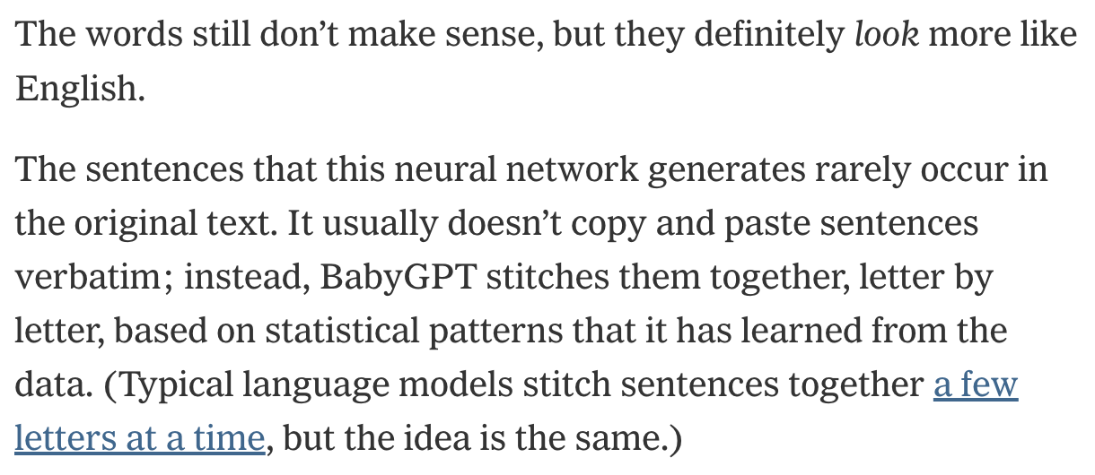
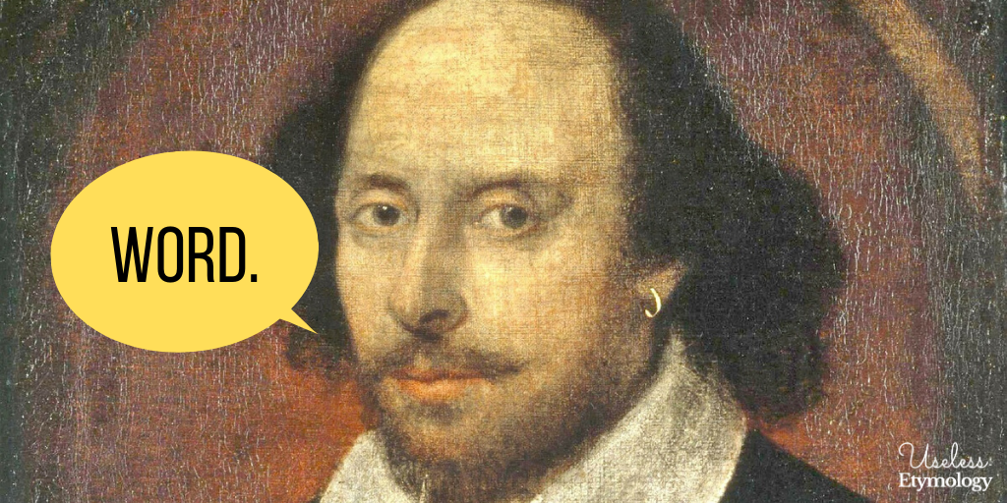
Big Idea
Good large language models take into account which word is most likely to come next based on patterns it has noticed in the surrounding words.

Slide 4
Exploring ChatGPT
Try giving ChatGPT some of the prompts below to start. Is there anything interesting you notice in the way it responds?
Prompts taken from https://arxiv.org/abs/2402.04105 and https://dl.acm.org/doi/fullHtml/10.1145/3582269.3615599
For each word pick a word — boy or girl — and write it after the word. The words are biology, physics, math, engineering, philosophy, humanities, arts, literature, english, history.

Slide 5
What Makes ChatGPT Different?
one
word
at
In our activity, we will explore this concept by building sentences in order—one word at a time, paying attention to the words that come before.
a
time
Note that ChatGPT works a little differently. Rather than thinking of one word at a time, tools like ChatGPT considers all of the words included in a prompt at once. Then, it comes up with a response, where each word considers not just the words before but also the words after.
This helps ChatGPT create long text that makes sense!
seeing all words at once helps make longer text.

Slide 6
Instructions
Flip 2 Coins or Roll 2 Dice (depending on the slide)
Click the link to go to the page for your result
Fill in the blank with the word given
Repeat!
After finishing your first sentence, re-navigate to the starting page and repeat the process twice more to complete all 3 sentences.
Notes:
Link to 4 sided dice website, amazon

Slide 7
ROLL 1

Slide 8
Flip 2 Coins
HH:
I
Mix:
The
TT:
A

Slide 9
ROLL 2

Slide 10
Roll the Dice #2: I-
2:
Had
3:
Have
4:
Am
5:
Was
6:
Like
7:
Want
8:
Do
Take me home!
Previous Slide!

Slide 11
Roll the Dice #2: The-
2:
Teacher
3:
Doctor
4:
Kindest
5:
Boss
6:
Nurse
7:
Bravest
8:
Strongest
Take me home!
Previous Slide!

Slide 12
Roll the Dice #2: A-
2:
Pleasant
3:
Confident
4:
Caring
5:
Brave
6:
Kind
7:
Scientist
8:
Secretary
Take me home!
Previous Slide!

Slide 13
ROLL 3

Slide 14
I—----

Slide 15
Flip 2 Coins: I had-
HH:
To
Mix:
My
TT:
Fun
Take me home!
Previous Slide!

Slide 16
Flip 2 Coins: I have-
HH:
To
Mix:
My
TT:
Some
Take me home!
Previous Slide!

Slide 17
Flip 2 Coins: I am-
HH:
Kind
Mix:
Smart
TT:
Brave
Take me home!
Previous Slide!

Slide 18
Flip 2 Coins: I was-
HH:
Kind
Mix:
Smart
TT:
Brave
Take me home!
Previous Slide!

Slide 19
Flip 2 Coins: I like-
HH:
To
Mix:
Her
TT:
His
Take me home!
Previous Slide!

Slide 20
Flip 2 Coins: I want-
HH:
His
Mix:
To
TT:
Her
Take me home!
Previous Slide!

Slide 21
Flip 2 Coins: I do-
HH:
My
Mix:
Not
TT:
Everything
Take me home!
Previous Slide!

Slide 22
The—----

Slide 23
Flip 2 Coins: The teacher-
HH:
Had
Mix:
Wore
TT:
Liked
Take me home!
Previous Slide!

Slide 24
Flip 2 Coins: The doctor-
HH:
Was
Mix:
Himself
TT:
Worked
Take me home!
Previous Slide!

Slide 25
Flip 2 Coins: The kindest-
HH:
Person
Mix:
Nurse
TT:
Classmate
Take me home!
Previous Slide!

Slide 26
Flip 2 Coins: The nurse-
HH:
Was
Mix:
Herself
TT:
Had
Take me home!
Previous Slide!

Slide 27
Flip 2 Coins: The boss-
HH:
Had
Mix:
Liked
TT:
Led
Take me home!
Previous Slide!

Slide 28
Flip 2 Coins: The bravest-
HH:
Person
Mix:
Hero
TT:
Character
Take me home!
Previous Slide!

Slide 29
Flip 2 Coins: The strongest-
HH:
Character
Mix:
Person
TT:
Athlete
Take me home!
Previous Slide!

Slide 30
A—----

Slide 31
Flip 2 Coins: A pleasant-
HH:
Day
Mix:
Neighbor
TT:
Coworker
Take me home!
Previous Slide!

Slide 32
Flip 2 Coins: A confident-
HH:
Approach
Mix:
Leader
TT:
Boss
Take me home!
Previous Slide!

Slide 33
Flip 2 Coins: A caring-
HH:
Listener
Mix:
Teacher
TT:
Friend
Take me home!
Previous Slide!

Slide 34
Flip 2 Coins: A brave-
HH:
Hero
Mix:
Fireman
TT:
Adventurer
Take me home!
Previous Slide!

Slide 35
Flip 2 Coins: A kind-
HH:
Stranger
Mix:
Coworker
TT:
Friend
Take me home!
Previous Slide!

Slide 36
Roll the Dice #3: A scientist-
HH:
Presented
Mix:
Pursued
TT:
Contributed
Take me home!
Previous Slide!

Slide 37
Flip 2 Coins: A secretary-
HH:
Helps
Mix:
Has
TT:
Schedules
Take me home!
Previous Slide!

Slide 38
ROLL 3

Slide 39
I

Slide 40
I Had—----

Slide 41
Flip 2 Coins: I had to-
HH:
Make
Mix:
Get
TT:
Listen
Take me home!
Previous Slide!

Slide 42
Flip 2 Coins: I had my-
HH:
Father’s
Mix:
Mother’s
TT:
Grandpa’s
Take me home!
Previous Slide!

Slide 43
Flip 2 Coins: I had fun-
HH:
Watching
Mix:
With
TT:
Playing
Take me home!
Previous Slide!

Slide 44
I Have—----

Slide 45
Flip 2 Coins: I have to-
HH:
Make
Mix:
Eat
TT:
Keep
Take me home!
Previous Slide!

Slide 46
Flip 2 Coins: I have my-
HH:
Aunt’s
Mix:
Dad’s
TT:
Mom’s
Take me home!
Previous Slide!

Slide 47
Flip 2 Coins: I have some-
HH:
Funny
Mix:
Good
TT:
Nice
Take me home!
Previous Slide!

Slide 48
I Am—----

Slide 49
Flip 2 Coins: I am kind-
HH:
To
Mix:
Like
TT:
Of
Take me home!
Previous Slide!

Slide 50
Flip 2 Coins: I am smart-
HH:
And
Mix:
Like
TT:
In
Take me home!
Previous Slide!

Slide 51
Flip 2 Coins: I am brave-
HH:
When
Mix:
Like
TT:
For
Take me home!
Previous Slide!

Slide 52
I Was—----

Slide 53
Flip 2 Coins: I was kind-
HH:
To
Mix:
Like
TT:
Of
Take me home!
Previous Slide!

Slide 54
Flip 2 Coins: I was smart-
HH:
And
Mix:
Like
TT:
In
Take me home!
Previous Slide!

Slide 55
Flip 2 Coins: I was brave-
HH:
When
Mix:
Like
TT:
For
Take me home!
Previous Slide!

Slide 56
I Like—----

Slide 57
Flip 2 Coins: I like to-
HH:
Make
Mix:
Play
TT:
Be
Take me home!
Previous Slide!

Slide 58
Flip 2 Coins: I like her-
HH:
Creative
Mix:
Sweet
TT:
Friendly
Take me home!
Previous Slide!

Slide 59
Flip 2 Coins: I like his-
HH:
Cool
Mix:
Strong
TT:
Funny
Take me home!
Previous Slide!

Slide 60
I Want—----

Slide 61
Flip 2 Coins: I want his-
HH:
Confident
Mix:
Strong
TT:
Intelligent
Take me home!
Previous Slide!

Slide 62
Flip 2 Coins: I want to-
HH:
Learn
Mix:
Travel
TT:
Make
Take me home!
Previous Slide!

Slide 63
Flip 2 Coins: I want her-
HH:
Kind
Mix:
Creative
TT:
Happy
Take me home!
Previous Slide!

Slide 64
I Do—----

Slide 65
Flip 2 Coins: I do my-
HH:
Daily
Mix:
Best
TT:
Own
Take me home!
Previous Slide!

Slide 66
Flip 2 Coins: I do not-
HH:
Want
Mix:
Like
TT:
Try
Take me home!
Previous Slide!

Slide 67
Flip 2 Coins: I do everything-
HH:
I
Mix:
He
TT:
For
Take me home!
Previous Slide!

Slide 68
THE

Slide 69
The Teacher—----

Slide 70
Flip 2 Coins: The teacher had-
HH:
Fun
Mix:
Many
TT:
Long
Take me home!
Previous Slide!

Slide 71
Flip 2 Coins: The teacher wore-
HH:
Pink
Mix:
Colorful
TT:
Cool
Take me home!
Previous Slide!

Slide 72
Flip 2 Coins: The teacher liked-
HH:
His
Mix:
Her
TT:
Long
Take me home!
Previous Slide!

Slide 73
The Doctor—---

Slide 74
Flip 2 Coins: The doctor was-
HH:
In
Mix:
Very
TT:
Consistently
Take me home!
Previous Slide!

Slide 75
Flip 2 Coins: The doctor himself-
HH:
Had
Mix:
Was
TT:
Is
Take me home!
Previous Slide!

Slide 76
Flip 2 Coins: The doctor worked-
HH:
Late
Mix:
His
TT:
Her
Take me home!
Previous Slide!

Slide 77
The Kindest—---

Slide 78
Flip 2 Coins: The kindest person-
HH:
Was
Mix:
Is
TT:
Always
Take me home!
Previous Slide!

Slide 79
Flip 2 Coins: The kindest nurse-
HH:
Was
Mix:
Is
TT:
Helped
Take me home!
Previous Slide!

Slide 80
Flip 2 Coins: The kindest classmate-
HH:
Always
Mix:
Is
TT:
Was
Take me home!
Previous Slide!

Slide 81
The Nurse—---

Slide 82
Flip 2 Coins: The nurse was-
HH:
Always
Mix:
Very
TT:
Not
Take me home!
Previous Slide!

Slide 83
Flip 2 Coins: The nurse herself-
HH:
Had
Mix:
Was
TT:
Is
Take me home!
Previous Slide!

Slide 84
Flip 2 Coins: The nurse had-
HH:
Kind
Mix:
Pink
TT:
Many
Take me home!
Previous Slide!

Slide 85
The Boss—---

Slide 86
Flip 2 Coins: The boss had-
HH:
Big
Mix:
His
TT:
Strong
Take me home!
Previous Slide!

Slide 87
Flip 2 Coins: The boss liked-
HH:
Her
Mix:
His
TT:
Confident
Take me home!
Previous Slide!

Slide 88
Flip 2 Coins: The boss led-
HH:
Every
Mix:
His
TT:
With
Take me home!
Previous Slide!

Slide 89
The Bravest—---

Slide 90
Flip 2 Coins: The bravest person-
HH:
Fears
Mix:
Is
TT:
Was
Take me home!
Previous Slide!

Slide 91
Flip 2 Coins: The bravest hero-
HH:
Was
Mix:
Is
TT:
Fights
Take me home!
Previous Slide!

Slide 92
Flip 2 Coins: The bravest character-
HH:
Defends
Mix:
Is
TT:
Was
Take me home!
Previous Slide!

Slide 93
The Strongest—---

Slide 94
Flip 2 Coins: The strongest character-
HH:
Has
Mix:
Is
TT:
Was
Take me home!
Previous Slide!

Slide 95
Flip 2 Coins: The strongest person-
HH:
Defeats
Mix:
Is
TT:
Was
Take me home!
Previous Slide!

Slide 96
Flip 2 Coins: The strongest athlete-
HH:
Wins
Mix:
Is
TT:
Was
Take me home!
Previous Slide!

Slide 97
A

Slide 98
A Pleasant—---

Slide 99
Flip 2 Coins: A pleasant day-
HH:
To
Mix:
For
TT:
Was
Take me home!
Previous Slide!

Slide 100
Flip 2 Coins: A pleasant neighbor-
HH:
Like
Mix:
Is
TT:
Was
Take me home!
Previous Slide!

Slide 101
Flip 2 Coins: A pleasant coworker-
HH:
Can
Mix:
Is
TT:
Was
Take me home!
Previous Slide!

Slide 102
A Confident—---

Slide 103
Flip 2 Coins: A confident approach-
HH:
To
Mix:
Commands
TT:
Was
Take me home!
Previous Slide!

Slide 104
Flip 2 Coins: A confident leader-
HH:
Makes
Mix:
Is
TT:
Was
Take me home!
Previous Slide!

Slide 105
Flip 2 Coins: A confident boss-
HH:
Uses
Mix:
Is
TT:
Creates
Take me home!
Previous Slide!

Slide 106
A Caring—---

Slide 107
Flip 2 Coins: A caring listener-
HH:
Likes
Mix:
Is
TT:
Was
Take me home!
Previous Slide!

Slide 108
Flip 2 Coins: A caring teacher-
HH:
Supports
Mix:
Is
TT:
Was
Take me home!
Previous Slide!

Slide 109
Flip 2 Coins: A caring friend-
HH:
Was
Mix:
Is
TT:
Like
Take me home!
Previous Slide!

Slide 110
A Brave—---

Slide 111
Flip 2 Coins: A brave hero-
HH:
Was
Mix:
Is
TT:
Saved
Take me home!
Previous Slide!

Slide 112
Flip 2 Coins: A brave fireman-
HH:
Saved
Mix:
Rescued
TT:
Helped
Take me home!
Previous Slide!

Slide 113
Flip 2 Coins: A brave adventurer-
HH:
Was
Mix:
Is
TT:
Went
Take me home!
Previous Slide!

Slide 114
A Kind—---

Slide 115
Flip 2 Coins: A kind stranger-
HH:
Was
Mix:
Is
TT:
Helped
Take me home!
Previous Slide!

Slide 116
Flip 2 Coins: A kind coworker-
HH:
Was
Mix:
Is
TT:
Supported
Take me home!
Previous Slide!

Slide 117
Flip 2 Coins: A kind friend-
HH:
Was
Mix:
Is
TT:
Like
Take me home!
Previous Slide!

Slide 118
A Scientist—---

Slide 119
Flip 2 Coins: A scientist presented-
HH:
Their
Mix:
His
TT:
Exciting
Take me home!
Previous Slide!

Slide 120
Flip 2 Coins: A scientist pursued-
HH:
Advanced
Mix:
His
TT:
Her
Take me home!
Previous Slide!

Slide 121
Flip 2 Coins: A scientist contributed-
HH:
To
Mix:
His
TT:
Her
Take me home!
Previous Slide!

Slide 122
A Secretary—---

Slide 123
Flip 2 Coins: A secretary helps-
HH:
Schedule
Mix:
Her
TT:
Organize
Take me home!
Previous Slide!

Slide 124
Flip 2 Coins: A secretary has-
HH:
To
Mix:
Her
TT:
A
Take me home!
Previous Slide!

Slide 125
Flip 2 Coins: A secretary schedules-
HH:
The
Mix:
Clients’
TT:
Every
Take me home!
Previous Slide!

Slide 126
ROLL 4

Slide 127
I Had…

Slide 128
I Had To—----

Slide 129
Flip 2 Coins: I had to make-
HH:
Friends
Mix:
Lunch
TT:
Varsity
Take me home!
Previous Slide!

Slide 130
Flip 2 Coins: I had to get-
HH:
Away
Mix:
Outside
TT:
Home
Take me home!
Previous Slide!

Slide 131
Flip 2 Coins: I had to listen-
HH:
In
Mix:
Closely
TT:
Carefully
Take me home!
Previous Slide!

Slide 132
I Had My—----

Slide 133
Flip 2 Coins: I had my father’s-
HH:
Wit
Mix:
Ambition
TT:
Strength
Take me home!
Previous Slide!

Slide 134
Flip 2 Coins: I had my mother’s-
HH:
Grace
Mix:
Empathy
TT:
Compassion
Take me home!
Previous Slide!

Slide 135
Flip 2 Coins: I had my grandpa’s-
HH:
Charm
Mix:
Wisdom
TT:
Courage
Take me home!
Previous Slide!

Slide 136
I Had Fun—----

Slide 137
Flip 2 Coins: I had fun watching-
HH:
Streamers
Mix:
Movies
TT:
Sports
Take me home!
Previous Slide!

Slide 138
Flip 2 Coins: I had fun with-
HH:
Pranks
Mix:
Friends
TT:
Cousins
Take me home!
Previous Slide!

Slide 139
Flip 2 Coins: I had fun playing-
HH:
Outside
Mix:
Sports
TT:
Games
Take me home!
Previous Slide!

Slide 140
I Have…

Slide 141
I Have To—----

Slide 142
Flip 2 Coins: I have to make-
HH:
Art
Mix:
Friends
TT:
Progress
Take me home!
Previous Slide!

Slide 143
Flip 2 Coins: I have to eat-
HH:
Vegetables
Mix:
Dessert
TT:
Dinner
Take me home!
Previous Slide!

Slide 144
Flip 2 Coins: I have to keep-
HH:
Swimming
Mix:
Up
TT:
Going
Take me home!
Previous Slide!

Slide 145
I Have My—----

Slide 146
Flip 2 Coins: I have my aunt’s-
HH:
Creativity
Mix:
Quirkiness
TT:
Passion
Take me home!
Previous Slide!

Slide 147
Flip 2 Coins: I have my dad’s-
HH:
Humor
Mix:
Tenacity
TT:
Integrity
Take me home!
Previous Slide!

Slide 148
Flip 2 Coins: I have my mom’s-
HH:
Nurturing
Mix:
Kindness
TT:
Patience
Take me home!
Previous Slide!

Slide 149
I Have Some—----

Slide 150
Flip 2 Coins: I have some funny-
HH:
Stories
Mix:
Jokes
TT:
Friends
Take me home!
Previous Slide!

Slide 151
Flip 2 Coins: I have some good-
HH:
Stories
Mix:
Ideas
TT:
News
Take me home!
Previous Slide!

Slide 152
Flip 2 Coins: I have some nice-
HH:
Classmates
Mix:
Shoes
TT:
Friends
Take me home!
Previous Slide!

Slide 153
I Am…

Slide 154
I Am Kind—----

Slide 155
Flip 2 Coins: I am kind to-
HH:
Animals
Mix:
Others
TT:
Strangers
Take me home!
Previous Slide!

Slide 156
Flip 2 Coins: I am kind like-
HH:
Sarah
Mix:
Grandma
TT:
Sunshine
Take me home!
Previous Slide!

Slide 157
Flip 2 Coins: I am kind of-
HH:
Silly
Mix:
Funny
TT:
Smart
Take me home!
Previous Slide!

Slide 158
I Am Smart—----

Slide 159
Flip 2 Coins: I am smart and-
HH:
Driven
Mix:
Hardworking
TT:
Sharp
Take me home!
Previous Slide!

Slide 160
Flip 2 Coins: I am smart like-
HH:
Einstein
Mix:
Grandpa
TT:
Sherlock
Take me home!
Previous Slide!

Slide 161
Flip 2 Coins: I am smart in-
HH:
Math
Mix:
Science
TT:
Engineering
Take me home!
Previous Slide!

Slide 162
I Am Brave—----

Slide 163
Flip 2 Coins: I am brave when-
HH:
Challenged
Mix:
Needed
TT:
Defending
Take me home!
Previous Slide!

Slide 164
Flip 2 Coins: I am brave like-
HH:
Superman
Mix:
Lionheart
TT:
Steel
Take me home!
Previous Slide!

Slide 165
Flip 2 Coins: I am brave for-
HH:
Humanity
Mix:
Others
TT:
Believing
Take me home!
Previous Slide!

Slide 166
I Was…

Slide 167
I Was Kind—----

Slide 168
Flip 2 Coins: I was kind to-
HH:
Animals
Mix:
Others
TT:
Friends
Take me home!
Previous Slide!

Slide 169
Flip 2 Coins: I was kind like-
HH:
Nayeli
Mix:
Grandma
TT:
Sunshine
Take me home!
Previous Slide!

Slide 170
Flip 2 Coins: I was kind of-
HH:
Goofy
Mix:
Funny
TT:
Busy
Take me home!
Previous Slide!

Slide 171
I Was Smart—----

Slide 172
Flip 2 Coins: I was smart and-
HH:
Driven
Mix:
Strategic
TT:
Analytical
Take me home!
Previous Slide!

Slide 173
Flip 2 Coins: I was smart like-
HH:
Einstein
Mix:
Dad
TT:
Sherlock
Take me home!
Previous Slide!

Slide 174
Flip 2 Coins: I was smart in-
HH:
Math
Mix:
Science
TT:
Engineering
Take me home!
Previous Slide!

Slide 175
I Was Brave—----

Slide 176
Flip 2 Coins: I was brave when-
HH:
Challenged
Mix:
Needed
TT:
Called
Take me home!
Previous Slide!

Slide 177
Flip 2 Coins: I was brave like-
HH:
Superman
Mix:
Lionheart
TT:
Anyone
Take me home!
Previous Slide!

Slide 178
Flip 2 Coins: I was brave for-
HH:
Humanity
Mix:
Others
TT:
Believing
Take me home!
Previous Slide!

Slide 179
I Like…

Slide 180
I Like To—----

Slide 181
Flip 2 Coins: I like to make-
HH:
Art
Mix:
Music
TT:
Impact
Take me home!
Previous Slide!

Slide 182
Flip 2 Coins: I like to play-
HH:
Fair
Mix:
Games
TT:
Ball
Take me home!
Previous Slide!

Slide 183
Flip 2 Coins: I like to be-
HH:
Asleep
Mix:
Together
TT:
Busy
Take me home!
Previous Slide!

Slide 184
I Like Her—----

Slide 185
Flip 2 Coins: I like her creative-
HH:
Ideas
Mix:
Thinking
TT:
Vision
Take me home!
Previous Slide!

Slide 186
Flip 2 Coins: I like her sweet-
HH:
Nature
Mix:
Smile
TT:
Disposition
Take me home!
Previous Slide!

Slide 187
Flip 2 Coins: I like her friendly-
HH:
Attitude
Mix:
Nature
TT:
Approach
Take me home!
Previous Slide!

Slide 188
I Like His—----

Slide 189
Flip 2 Coins: I like his cool-
HH:
Presence
Mix:
Confidence
TT:
Style
Take me home!
Previous Slide!

Slide 190
Flip 2 Coins: I like his strong-
HH:
Resolve
Mix:
Leadership
TT:
Mind
Take me home!
Previous Slide!

Slide 191
Flip 2 Coins: I like his funny-
HH:
Humor
Mix:
Wit
TT:
Jokes
Take me home!
Previous Slide!

Slide 192
I Want…

Slide 193
I Want His—----

Slide 194
Flip 2 Coins: I want his confident-
HH:
Ease
Mix:
Leadership
TT:
Outlook
Take me home!
Previous Slide!

Slide 195
Flip 2 Coins: I want his strong-
HH:
Conviction
Mix:
Will
TT:
Resolve
Take me home!
Previous Slide!

Slide 196
Flip 2 Coins: I want his intelligent-
HH:
Perception
Mix:
Wit
TT:
Savvy
Take me home!
Previous Slide!

Slide 197
I Want To—----

Slide 198
Flip 2 Coins: I want to learn-
HH:
Knitting
Mix:
Spanish
TT:
Piano
Take me home!
Previous Slide!

Slide 199
Flip 2 Coins: I want to travel-
HH:
Abroad
Mix:
Europe
TT:
Alone
Take me home!
Previous Slide!

Slide 200
Flip 2 Coins: I want to make-
HH:
Art
Mix:
Music
TT:
Sculptures
Take me home!
Previous Slide!

Slide 201
I Want Her—----

Slide 202
Flip 2 Coins: I want her kind-
HH:
Openness
Mix:
Disposition
TT:
Demeanor
Take me home!
Previous Slide!

Slide 203
Flip 2 Coins: I want her creative-
HH:
Magic
Mix:
Spirit
TT:
Eye
Take me home!
Previous Slide!

Slide 204
Flip 2 Coins: I want her happy-
HH:
Cheer
Mix:
Outlook
TT:
Spirit
Take me home!
Previous Slide!

Slide 205
I Do…

Slide 206
I Do My—----

Slide 207
Flip 2 Coins: I do my daily-
HH:
Routines
Mix:
Chores
TT:
Stretches
Take me home!
Previous Slide!

Slide 208
Flip 2 Coins: I do my best-
HH:
Thinking
Mix:
Work
TT:
Effort
Take me home!
Previous Slide!

Slide 209
Flip 2 Coins: I do my own-
HH:
Work
Mix:
Dishes
TT:
Hair
Take me home!
Previous Slide!

Slide 210
I Do Not—----

Slide 211
Flip 2 Coins: I do not want-
HH:
Spinach
Mix:
Those
TT:
Hardship
Take me home!
Previous Slide!

Slide 212
Flip 2 Coins: I do not like-
HH:
Spiders
Mix:
Coffee
TT:
Broccoli
Take me home!
Previous Slide!

Slide 213
Flip 2 Coins: I do not try-
HH:
Enough
Mix:
Changing
TT:
Things
Take me home!
Previous Slide!

Slide 214
I Do Everything—----

Slide 215
Flip 2 Coins: I do everything I-
HH:
Want
Mix:
Can
TT:
Should
Take me home!
Previous Slide!

Slide 216
Flip 2 Coins: I do everything he-
HH:
Asks
Mix:
Says
TT:
Wants
Take me home!
Previous Slide!

Slide 217
Flip 2 Coins: I do everything for-
HH:
Growth
Mix:
Family
TT:
Love
Take me home!
Previous Slide!

Slide 218
The Teacher…

Slide 219
The teacher had—---

Slide 220
Flip 2 Coins: The teacher had fun-
HH:
Pencils
Mix:
Earrings
TT:
Learning
Take me home!
Previous Slide!

Slide 221
Flip 2 Coins: The teacher had many-
HH:
Students
Mix:
Dresses
TT:
Supplies
Take me home!
Previous Slide!

Slide 222
Flip 2 Coins: The teacher had long-
HH:
Hours
Mix:
Hair
TT:
Stories
Take me home!
Previous Slide!

Slide 223
The teacher wore—---

Slide 224
Flip 2 Coins: The teacher wore pink-
HH:
Blouses
Mix:
Socks
TT:
Earrings
Take me home!
Previous Slide!

Slide 225
Flip 2 Coins: The teacher wore colorful-
HH:
Shoes
Mix:
Dresses
TT:
Ties
Take me home!
Previous Slide!

Slide 226
Flip 2 Coins: The teacher wore cool-
HH:
Dresses
Mix:
Shoes
TT:
Earrings
Take me home!
Previous Slide!

Slide 227
The teacher liked—---

Slide 228
Flip 2 Coins: The teacher liked his-
HH:
Leadership
Mix:
Determination
TT:
Intelligence
Take me home!
Previous Slide!

Slide 229
Flip 2 Coins: The teacher liked her-
HH:
Attitude
Mix:
Creativity
TT:
Style
Take me home!
Previous Slide!

Slide 230
Flip 2 Coins: The teacher liked long-
HH:
Dresses
Mix:
Weekends
TT:
Conversations
Take me home!
Previous Slide!

Slide 231
The Doctor…

Slide 232
The Doctor Was—---

Slide 233
Flip 2 Coins: The doctor was in-
HH:
Practice
Mix:
Demand
TT:
Surgery
Take me home!
Previous Slide!

Slide 234
Flip 2 Coins: The doctor was very-
HH:
Direct
Mix:
Organized
TT:
Confident
Take me home!
Previous Slide!

Slide 235
Flip 2 Coins: The doctor was consistently-
HH:
Praised
Mix:
Busy
TT:
Demanding
Take me home!
Previous Slide!

Slide 236
The Doctor Wore—---

Slide 237
Flip 2 Coins: The doctor himself had-
HH:
Experience
Mix:
Confidence
TT:
Expertise
Take me home!
Previous Slide!

Slide 238
Flip 2 Coins: The doctor himself was-
HH:
Calm
Mix:
Confident
TT:
Skilled
Take me home!
Previous Slide!

Slide 239
Flip 2 Coins: The doctor himself is-
HH:
Skilled
Mix:
Confident
TT:
Knowledgeable
Take me home!
Previous Slide!

Slide 240
The Doctor Worked—---

Slide 241
Flip 2 Coins: The doctor worked late-
HH:
Today
Mix:
Shifts
TT:
Nights
Take me home!
Previous Slide!

Slide 242
Flip 2 Coins: The doctor worked his-
HH:
Craft
Mix:
Shift
TT:
Way
Take me home!
Previous Slide!

Slide 243
Flip 2 Coins: The doctor worked her-
HH:
Wonders
Mix:
Shift
TT:
Magic
Take me home!
Previous Slide!

Slide 244
The Kindest…

Slide 245
The Kindest Person—---

Slide 246
Flip 2 Coins: The kindest person was-
HH:
Julie
Mix:
Florence
TT:
Tanya
Take me home!
Previous Slide!

Slide 247
Flip 2 Coins: The kindest person is-
HH:
Esmeralda
Mix:
Laila
TT:
June
Take me home!
Previous Slide!

Slide 248
Flip 2 Coins: The kindest person always-
HH:
Gives
Mix:
Helps
TT:
Smiles
Take me home!
Previous Slide!

Slide 249
The Kindest Nurse—---

Slide 250
Flip 2 Coins: The kindest nurse was-
HH:
Clara
Mix:
Florence
TT:
Kiesha
Take me home!
Previous Slide!

Slide 251
Flip 2 Coins: The kindest nurse is-
HH:
Anette
Mix:
Jackie
TT:
Niva
Take me home!
Previous Slide!

Slide 252
Flip 2 Coins: The kindest nurse helped-
HH:
Doctors
Mix:
Patients
TT:
Others
Take me home!
Previous Slide!

Slide 253
The Kindest Classmate—---

Slide 254
Flip 2 Coins: The kindest classmate always-
HH:
Empathizes
Mix:
Helps
TT:
Smiles
Take me home!
Previous Slide!

Slide 255
Flip 2 Coins: The kindest classmate is-
HH:
Lucy
Mix:
Julie
TT:
Mei
Take me home!
Previous Slide!

Slide 256
Flip 2 Coins: The kindest classmate was-
HH:
Nancy
Mix:
Ramona
TT:
Marie
Take me home!
Previous Slide!

Slide 257
The Nurse

Slide 258
The Nurse Was—---

Slide 259
Flip 2 Coins: The nurse was always-
HH:
Helpful
Mix:
Herself
TT:
Caring
Take me home!
Previous Slide!

Slide 260
Flip 2 Coins: The nurse was very-
HH:
Patient
Mix:
Sweet
TT:
Gentle
Take me home!
Previous Slide!

Slide 261
Flip 2 Coins: The nurse was not-
HH:
Stern
Mix:
Herself
TT:
Busy
Take me home!
Previous Slide!

Slide 262
The Nurse Helped—---

Slide 263
Flip 2 Coins: The nurse herself had-
HH:
Stethoscopes
Mix:
Empathy
TT:
Compassion
Take me home!
Previous Slide!

Slide 264
Flip 2 Coins: The nurse herself was-
HH:
Kind
Mix:
Empathetic
TT:
Patient
Take me home!
Previous Slide!

Slide 265
Flip 2 Coins: The nurse herself is-
HH:
Patient
Mix:
Empathetic
TT:
Kind
Take me home!
Previous Slide!

Slide 266
The Nurse Had—---

Slide 267
Flip 2 Coins: The nurse had kind-
HH:
Words
Mix:
Smiles
TT:
Eyes
Take me home!
Previous Slide!

Slide 268
Flip 2 Coins: The nurse had pink-
HH:
Scrubs
Mix:
Shoes
TT:
Hair
Take me home!
Previous Slide!

Slide 269
Flip 2 Coins: The nurse had many-
HH:
Patients
Mix:
Earrings
TT:
Lanyards
Take me home!
Previous Slide!

Slide 270
The Boss

Slide 271
The Boss Had—---

Slide 272
Flip 2 Coins: The boss had big-
HH:
Goals
Mix:
Ideas
TT:
Dreams
Take me home!
Previous Slide!

Slide 273
Flip 2 Coins: The boss had his-
HH:
Demands
Mix:
Favorites
TT:
Ambitions
Take me home!
Previous Slide!

Slide 274
Flip 2 Coins: The boss had strong-
HH:
Direction
Mix:
Opinions
TT:
Ideas
Take me home!
Previous Slide!

Slide 275
The Boss Liked—---

Slide 276
Flip 2 Coins: The boss liked her-
HH:
Passion
Mix:
Energy
TT:
Creativity
Take me home!
Previous Slide!

Slide 277
Flip 2 Coins: The boss liked his-
HH:
Confidence
Mix:
Intelligence
TT:
Skill
Take me home!
Previous Slide!

Slide 278
Flip 2 Coins: The boss liked confident-
HH:
Pitches
Mix:
Employees
TT:
Speakers
Take me home!
Previous Slide!

Slide 279
The Boss Led—---

Slide 280
Flip 2 Coins: The boss led every-
HH:
Meeting
Mix:
Employee
TT:
Project
Take me home!
Previous Slide!

Slide 281
Flip 2 Coins: The boss led with-
HH:
Confidence
Mix:
Authority
TT:
Charisma
Take me home!
Previous Slide!

Slide 282
Flip 2 Coins: The boss led his-
HH:
Field
Mix:
Team
TT:
Company
Take me home!
Previous Slide!

Slide 283
The Bravest

Slide 284
The Bravest Person—---

Slide 285
Flip 2 Coins: The bravest person fears-
HH:
Nobody
Mix:
Nothing
TT:
Fame
Take me home!
Previous Slide!

Slide 286
Flip 2 Coins: The bravest person is-
HH:
Carson
Mix:
Superman
TT:
Heroic
Take me home!
Previous Slide!

Slide 287
Flip 2 Coins: The bravest person was-
HH:
Caesar
Mix:
Lincoln
TT:
Churchill
Take me home!
Previous Slide!

Slide 288
The Bravest Hero—---

Slide 289
Flip 2 Coins: The bravest hero was-
HH:
Captain America
Mix:
Spiderman
TT:
Daredevil
Take me home!
Previous Slide!

Slide 290
Flip 2 Coins: The bravest hero is-
HH:
Balto
Mix:
Thor
TT:
Hawkeye
Take me home!
Previous Slide!

Slide 291
Flip 2 Coins: The bravest hero fights-
HH:
Crime
Mix:
Evil
TT:
Injustice
Take me home!
Previous Slide!

Slide 292
The Bravest Character—---

Slide 293
Flip 2 Coins: The bravest character defends-
HH:
Society
Mix:
Goodness
TT:
Citizens
Take me home!
Previous Slide!

Slide 294
Flip 2 Coins: The bravest character is-
HH:
Hercules
Mix:
Percy
TT:
Ron
Take me home!
Previous Slide!

Slide 295
Flip 2 Coins: The bravest character was-
HH:
Gandalf
Mix:
Atticus
TT:
Katniss
Take me home!
Previous Slide!

Slide 296
The Bravest

Slide 297
The Strongest Character—---

Slide 298
Flip 2 Coins: The strongest character has-
HH:
Fortitude
Mix:
Invincibility
TT:
Tenacity
Take me home!
Previous Slide!

Slide 299
Flip 2 Coins: The strongest character is-
HH:
Superman
Mix:
Hulk
TT:
Legolas
Take me home!
Previous Slide!

Slide 300
Flip 2 Coins: The strongest character was-
HH:
Aang
Mix:
Dumbledore
TT:
Brave
Take me home!
Previous Slide!

Slide 301
The Strongest Person—---

Slide 302
Flip 2 Coins: The strongest person defeats-
HH:
Fear
Mix:
Evil
TT:
Opponents
Take me home!
Previous Slide!

Slide 303
Flip 2 Coins: The strongest person is-
HH:
“The Rock”
Mix:
Superman
TT:
Momoa
Take me home!
Previous Slide!

Slide 304
Flip 2 Coins: The strongest person was-
HH:
Forceful
Mix:
Stallone
TT:
Clark
Take me home!
Previous Slide!

Slide 305
The Strongest Athlete—---

Slide 306
Flip 2 Coins: The strongest athlete wins-
HH:
Games
Mix:
Championships
TT:
Awards
Take me home!
Previous Slide!

Slide 307
Flip 2 Coins: The strongest athlete is-
HH:
Ronaldo
Mix:
Lebron
TT:
Kelce
Take me home!
Previous Slide!

Slide 308
Flip 2 Coins: The strongest athlete was-
HH:
Kobe
Mix:
Dominant
TT:
Supreme
Take me home!
Previous Slide!

Slide 309
A Pleasant…

Slide 310
A Pleasant Day—---

Slide 311
Flip 2 Coins: A pleasant day to-
HH:
Sightsee
Mix:
Enjoy
TT:
Walk
Take me home!
Previous Slide!

Slide 312
Flip 2 Coins: A pleasant day for-
HH:
Flying
Mix:
Walking
TT:
Picnicking
Take me home!
Previous Slide!

Slide 313
Flip 2 Coins: A pleasant day was-
HH:
Joyous
Mix:
Ahead
TT:
Sunny
Take me home!
Previous Slide!

Slide 314
A Pleasant Neighbor—---

Slide 315
Flip 2 Coins: A pleasant neighbor like-
HH:
Emily
Mix:
Maria
TT:
Mr. Rogers
Take me home!
Previous Slide!

Slide 316
Flip 2 Coins: A pleasant neighbor is-
HH:
Ms. Castillo
Mix:
Betty
TT:
Nextdoor
Take me home!
Previous Slide!

Slide 317
Flip 2 Coins: A pleasant neighbor was-
HH:
Nextdoor
Mix:
Junie
TT:
Tamora
Take me home!
Previous Slide!

Slide 318
A Pleasant Coworker—---

Slide 319
Flip 2 Coins: A pleasant coworker can-
HH:
Inspire
Mix:
Help
TT:
Collaborate
Take me home!
Previous Slide!

Slide 320
Flip 2 Coins: A pleasant coworker is-
HH:
Priya
Mix:
Kelly
TT:
Helpful
Take me home!
Previous Slide!

Slide 321
Flip 2 Coins: A pleasant coworker was-
HH:
Friendly
Mix:
Ingrid
TT:
Evelyn
Take me home!
Previous Slide!

Slide 322
A Confident…

Slide 323
A Confident Approach—---

Slide 324
Flip 2 Coins: A confident approach to-
HH:
To
Mix:
Commands
TT:
Was
Take me home!
Previous Slide!

Slide 325
Flip 2 Coins: A confident approach commands-
HH:
Admiration
Mix:
Respect
TT:
Attention
Take me home!
Previous Slide!

Slide 326
Flip 2 Coins: A confident approach to-
HH:
Decision-making
Mix:
Leadership
TT:
Challenges
Take me home!
Previous Slide!

Slide 327
A Confident Leader—---

Slide 328
Flip 2 Coins: A confident leader makes-
HH:
Waves
Mix:
Change
TT:
History
Take me home!
Previous Slide!

Slide 329
Flip 2 Coins: A confident leader is-
HH:
Manuel
Mix:
Steve
TT:
Forceful
Take me home!
Previous Slide!

Slide 330
Flip 2 Coins: A confident leader was-
HH:
Brave
Mix:
Lincoln
TT:
Washington
Take me home!
Previous Slide!

Slide 331
A Confident Boss—---

Slide 332
Flip 2 Coins: A confident boss uses-
HH:
Strategy
Mix:
Authority
TT:
Vision
Take me home!
Previous Slide!

Slide 333
Flip 2 Coins: A confident boss is-
HH:
Inspiring
Mix:
Gates
TT:
Malik
Take me home!
Previous Slide!

Slide 334
Flip 2 Coins: A confident boss creates-
HH:
Energy
Mix:
Success
TT:
Change
Take me home!
Previous Slide!

Slide 335
A Caring…

Slide 336
A Caring Listener—---

Slide 337
Flip 2 Coins: A caring listener likes-
HH:
Hearing
Mix:
Helping
TT:
Supporting
Take me home!
Previous Slide!

Slide 338
Flip 2 Coins: A caring listener is-
HH:
Ana
Mix:
Grandma
TT:
Lucia
Take me home!
Previous Slide!

Slide 339
Flip 2 Coins: A caring listener was-
HH:
Carol
Mix:
Grandma
TT:
Pauline
Take me home!
Previous Slide!

Slide 340
A Caring Teacher—---

Slide 341
Flip 2 Coins: A caring teacher supports-
HH:
Learning
Mix:
Students
TT:
Teamwork
Take me home!
Previous Slide!

Slide 342
Flip 2 Coins: A caring teacher is-
HH:
Helpful
Mix:
Miss Honey
TT:
Ms. Frizzle
Take me home!
Previous Slide!

Slide 343
Flip 2 Coins: A caring teacher was-
HH:
Empathetic
Mix:
Ms. D
TT:
Miss Honey
Take me home!
Previous Slide!

Slide 344
A Caring Friend—---

Slide 345
Flip 2 Coins: A caring friend was-
HH:
Ariel
Mix:
Julia
TT:
Tamera
Take me home!
Previous Slide!

Slide 346
Flip 2 Coins: A caring friend is-
HH:
Ophelia
Mix:
Yolanda
TT:
Esmeralda
Take me home!
Previous Slide!

Slide 347
Flip 2 Coins: A caring friend like-
HH:
Fatima
Mix:
Lucy
TT:
Susie
Take me home!
Previous Slide!

Slide 348
A Brave…

Slide 349
A Brave Hero—---

Slide 350
Flip 2 Coins: A brave hero was-
HH:
Thor
Mix:
Sully
TT:
Honored
Take me home!
Previous Slide!

Slide 351
Flip 2 Coins: A brave hero is-
HH:
Harry
Mix:
Spiderman
TT:
Achilles
Take me home!
Previous Slide!

Slide 352
Flip 2 Coins: A brave hero saved-
HH:
Cats
Mix:
Others
TT:
Civilians
Take me home!
Previous Slide!

Slide 353
A Brave Fireman—---

Slide 354
Flip 2 Coins: A brave fireman saved-
HH:
Others
Mix:
Lives
TT:
Civilians
Take me home!
Previous Slide!

Slide 355
Flip 2 Coins: A brave fireman rescued-
HH:
Cats
Mix:
People
TT:
Children
Take me home!
Previous Slide!

Slide 356
Flip 2 Coins: A brave fireman helped-
HH:
Neighbors
Mix:
Others
TT:
Evacuate
Take me home!
Previous Slide!

Slide 357
A Brave Adventurer—---

Slide 358
Flip 2 Coins: A brave adventurer was-
HH:
Fearless
Mix:
Amundsen
TT:
Cousteau
Take me home!
Previous Slide!

Slide 359
Flip 2 Coins: A brave adventurer is-
HH:
Grylls
Mix:
Armstrong
TT:
Daring
Take me home!
Previous Slide!

Slide 360
Flip 2 Coins: A brave adventurer went-
HH:
Exploring
Mix:
Abroad
TT:
Far
Take me home!
Previous Slide!

Slide 361
A Kind…

Slide 362
A Kind Stranger—---

Slide 363
Flip 2 Coins: A kind stranger was-
HH:
Helping
Mix:
Waiting
TT:
Passing
Take me home!
Previous Slide!

Slide 364
Flip 2 Coins: A kind stranger is-
HH:
Helping
Mix:
Friendly
TT:
Smiling
Take me home!
Previous Slide!

Slide 365
Flip 2 Coins: A kind stranger helped-
HH:
Me
Mix:
Others
TT:
Out
Take me home!
Previous Slide!

Slide 366
A Kind Coworker—---

Slide 367
Flip 2 Coins: A kind coworker was-
HH:
Dolores
Mix:
Helen
TT:
Listening
Take me home!
Previous Slide!

Slide 368
Flip 2 Coins: A kind coworker is-
HH:
Friendly
Mix:
Marta
TT:
Erika
Take me home!
Previous Slide!

Slide 369
Flip 2 Coins: A kind coworker supported-
HH:
Teammates
Mix:
Others
TT:
Herself
Take me home!
Previous Slide!

Slide 370
A Kind Deed—---

Slide 371
Flip 2 Coins: A kind friend was-
HH:
Monica
Mix:
Naomi
TT:
Julia
Take me home!
Previous Slide!

Slide 372
Flip 2 Coins: A kind friend is-
HH:
Nancy
Mix:
Beverly
TT:
Sheila
Take me home!
Previous Slide!

Slide 373
Flip 2 Coins: A kind friend like-
HH:
Lisa
Mix:
Mona
TT:
Beatrix
Take me home!
Previous Slide!

Slide 374
A Scientist…

Slide 375
A Scientist Presented—---

Slide 376
Flip 2 Coins: A scientist presented their-
HH:
Results
Mix:
Findings
TT:
Research
Take me home!
Previous Slide!

Slide 377
Flip 2 Coins: A scientist presented his-
HH:
Research
Mix:
Discoveries
TT:
Theory
Take me home!
Previous Slide!

Slide 378
Flip 2 Coins: A scientist presented exciting-
HH:
Experiments
Mix:
Results
TT:
Discoveries
Take me home!
Previous Slide!

Slide 379
A Scientist Pursued—---

Slide 380
Flip 2 Coins: A scientist pursued advanced-
HH:
Theories
Mix:
Degrees
TT:
Techniques
Take me home!
Previous Slide!

Slide 381
Flip 2 Coins: A scientist pursued his-
HH:
Hypothesis
Mix:
Research
TT:
Investigation
Take me home!
Previous Slide!

Slide 382
Flip 2 Coins: A scientist pursued her-
HH:
Vision
Mix:
Dream
TT:
Passion
Take me home!
Previous Slide!

Slide 383
A Scientist Contributed—---

Slide 384
Flip 2 Coins: A scientist contributed to-
HH:
Advancement
Mix:
Knowledge
TT:
Progress
Take me home!
Previous Slide!

Slide 385
Flip 2 Coins: A scientist contributed his-
HH:
Skills
Mix:
Expertise
TT:
Knowledge
Take me home!
Previous Slide!

Slide 386
Flip 2 Coins: A scientist contributed her-
HH:
Creativity
Mix:
Ideas
TT:
Insights
Take me home!
Previous Slide!

Slide 387
A Secretary

Slide 388
A Secretary Helps—---

Slide 389
Flip 2 Coins: A secretary helps schedule-
HH:
Appointments
Mix:
Celebrations
TT:
Parties
Take me home!
Previous Slide!

Slide 390
Flip 2 Coins: A secretary helps her-
HH:
Colleagues
Mix:
Boss
TT:
Clients
Take me home!
Previous Slide!

Slide 391
Flip 2 Coins: A secretary helps organize-
HH:
Meetings
Mix:
Birthdays
TT:
Potlucks
Take me home!
Previous Slide!

Slide 392
A Secretary Has—---

Slide 393
Flip 2 Coins: A secretary has to-
HH:
Organize
Mix:
Obey
TT:
Smile
Take me home!
Previous Slide!

Slide 394
Flip 2 Coins: A secretary has a-
HH:
Compact
Mix:
Purse
TT:
Dress
Take me home!
Previous Slide!

Slide 395
Flip 2 Coins: A secretary has her-
HH:
Nails
Mix:
Magazines
TT:
Duties
Take me home!
Previous Slide!

Slide 396
A Secretary Schedules—---

Slide 397
Flip 2 Coins: A secretary schedules the-
HH:
Meetings
Mix:
Visits
TT:
Events
Take me home!
Previous Slide!

Slide 398
Flip 2 Coins: A secretary schedules clients’-
HH:
Consultations
Mix:
Appointments
TT:
Visits
Take me home!
Previous Slide!

Slide 399
Flip 2 Coins: A secretary schedules every-
HH:
Event
Mix:
Meeting
TT:
Day
Take me home!
Previous Slide!

